Slide 1

Predicting customer buying behaviour
22/05/2023

Slide 2
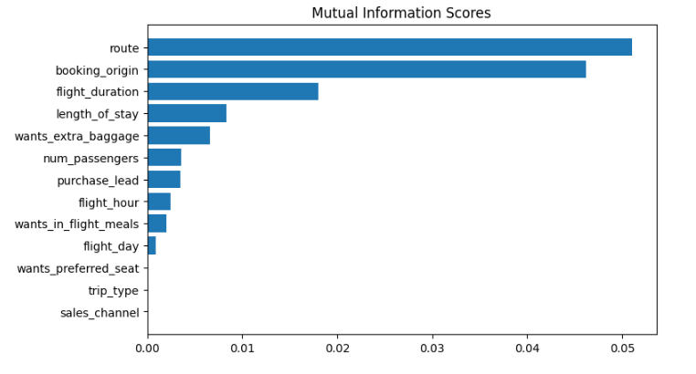
predictive model to understand factors that influence buying behaviour
The best performing model was Random Forest Classifier
Metrics:
ACCURACY: 84.82
AUC score: 0.546
route
booking_origin
flight_duration
wants_extra_baggage
length_of_stay
are the top 5 features which influence
Customer buying behavior.

